Slide 1
One and Two Sample Estimation Problems
Chapter 9

Slide 2
Estimating Mean

Slide 3
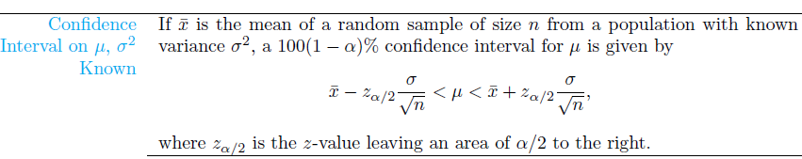

Slide 4
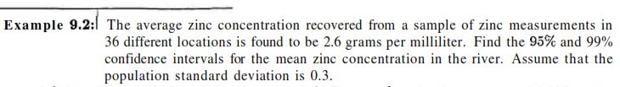

Slide 5
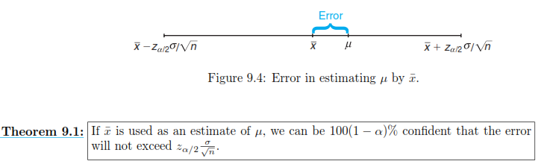

Error in Estimating μ by $\overline{X}$

Slide 6
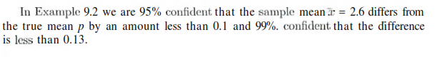

Slide 7
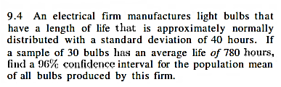

Slide 8
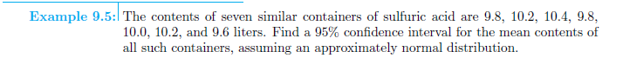

Slide 9
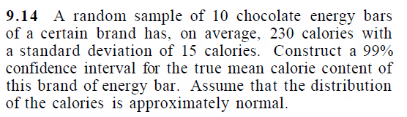


Slide 10

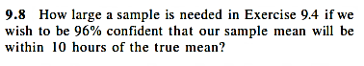

Slide 11
Ex: 9.4 – 9.18

